Slide 1


Citizenship Application Fee Waivers Policy and Process
September 2022
Chair
Katie Fennell, CELC
Presenters
Rebecca Flint, Islington Law Centre, KIND Supervising Solicitor
Sumita Gupta, Islington Law Centre, KIND Supervising Solicitor
Contributors
KiND client
Melissa Dames, Arnold & Porter

Slide 2

In this Training
A Client's Experience of the Fee Waiver: A client’s experience of the fee waiver process in leave to remain applications
Introducing the Citizenship Fee Waiver Policy: A brief introduction to the Home Office citizenship application fee waiver policy for children under 18 (Rebecca Flint, Islington Law Centre, KIND Supervising Solicitor)
Evidencing Fee Waiver Applications: experience of a KiND supervisor on leave to remain applications (Sumita Gupta, Islington Law Centre, KIND Supervising Solicitor)
Working With Children and Families
Top Tips: from a KiND pro bono lawyer on leave to remain fee waiver applications (Melissa Dames, Solicitor , Arnold & Porter )
Questions
_____
September 2022

Slide 3
1.
A client's experience of the fee waiver
Q and A with a KiND client and Sumita Gupta, Islington Law Centre, KIND Supervising Solicitor

Slide 4


Interview with Mistura

Slide 5
2.
Introducing the Citizenship Fee Waiver Policy
Rebecca Flint
Islington Law Centre, KIND Supervising Solicitor

Slide 6

The Fee Waiver
2.​ Introducing the Citizenship Fee Waiver Policy
Children are now eligible to apply for a fee waiver to cover the full cost of the application fee.
    The guidance: Affordability fee waiver: Citizenship registration for individuals under the age of 18 Version 1.0
    Read this!
It is important to refer to the current policy when preparing your application as they show you what you will need to demonstrate to make a successful application
_____
September 2022

Slide 7
Background to the changes
2.​ Introducing the Citizenship Fee Waiver Policy
Following litigation in 2019 pursued by PRCBC (PRCBC, O&A v SSHD), confirmed by the CA in 2021, the HO, in May 2022, finally reviewed their fee policy for citizenship applications.
The HC and the CA found that the registration fee was unlawful in that the fees were set without the SSHD considering the best interests of the child, as per their statutory duties under s55 BCIA 2009.
_____
September 2022

Slide 8
Background to the changes
2.​ Introducing the Citizenship Fee Waiver Policy
The HO carried out an impact assessment.
This considered the impacts of the costs of the fees on, ‘some children’s ability to register as a British Citizen and consequential impacts on their individual rights both in childhood and later adulthood, and on their wider wellbeing’.
Such consequences to an individual were evidenced by PRCBC in their litigation.
Resulting in a welcome change for our client group!
________
September 2022

Slide 9
The changes
2.​ Introducing the Citizenship Fee Waiver Policy
The fee waiver allows for the whole fee of £1012 to be waived.
It also allows for the Citizenship Ceremony fee of £80.00 to be waived if a client turns 18 whilst the application is pending.
Looked After Children are not required to pay the fees.
NB: Children supported by Local Authorities under s17 are still required to apply for the fee waiver- but in reality the level of support is low, should be successfully applied.
Siblings can apply for a fee waiver - the whole family’s income will be assessed. Elder sibling granted first if part fee waiver.
________
September 2022

Slide 10
The
Test
2.​ Introducing the Citizenship Fee Waiver Policy
Is one of affordability.
This is defined slightly differently throughout the HO guidance …
________
September 2022

Slide 11
2.​ Introducing the Citizenship Fee Waiver Policy
A fee waiver must be granted if the applicant and parent(s) are assessed and found:
  to credibly demonstrate they cannot afford the fee
  that their income is not sufficient to meet the child’s needs
The primary consideration on whether someone is eligible for a fee waiver is an affordability test to assess whether the applicant and parent(s) have credibly demonstrated that they cannot afford the fee.
This applies when the applicant and parent(s) do not have sufficient funds at their disposal, after meeting their essential living needs, to pay the fee.
Thresholds for a successful Fee Waiver
________
September 2022

Slide 12
2.​ Introducing the Citizenship Fee Waiver Policy
The need to safeguard and promote the welfare of a child in the UK should be a primary consideration in deciding any claim.
This means careful consideration needs to be given as to whether the applicant’s needs are being met and whether being required to pay the fee would deprive a child of having these needs met.
S55 Borders, Citizenship &
Immigration Act 2009
obligations
________
September 2022

Slide 13
Essential Needs
2.​ Introducing the Citizenship Fee Waiver Policy
  Essential needs are defined in the guidance as ‘housing and food’. P1
  Further, ‘This includes housing or accommodation, utilities, food, clothing, toiletries, non-prescription medication, and household cleaning items. It would also include the costs of travel and communication to enable the supported persons to maintain interpersonal relationships and access a reasonable level of social, cultural and religious life. p13
________
September 2022

Slide 14
Essential Needs
2.​ Introducing the Citizenship Fee Waiver Policy
  The Fee Waiver guidance also refers to this HO guidance relating to payments made to asylum seekers and failed asylum seekers.
  The amount specified for essential items per week is illuminating:
    Clothes + footwear: £3.01
    Food + non-alcoholic drinks: £26.89
    Toiletries : £0.69
    Travel: £4.70
________
September 2022

Slide 15
Assessing Affordability
2.​ Introducing the Citizenship Fee Waiver Policy
Assess:
  Income and savings available once accommodation and essential living needs for the applicant (child), parent(s) and any dependents have been met.
  Can they either pay for or save for the application fee.
Applicants must demonstrate:
  Taking into account all essentials, they cannot afford the fee
  Needs are met by others – NGO, LA, friends, foodbanks etc.
  They cannot save sufficient funds for fee (over a 6 month period)
  Expenditure higher than income
  MUST PROVIDE CLEAR AND COMPELLING EVIDENCE
________
September 2022

Slide 16
Assessing Affordability
2.​ Introducing the Citizenship Fee Waiver Policy
There is a list of questions at p13 of the guidance which indicates what the HO will be looking for when considering the evidence submitted:
  How does the applicant and parent(s), meet their essential living needs? (Who pays for? Donations?)
  Income? All sources, assessed over a 6-month period
  Surplus income, excluding accommodation and essential living needs, that could be used to pay the fee?
  Any non-essential and excessive purchases, such as money spent on holidays, or luxury items?
  Is the applicant or parent(s) financially dependent on someone who can afford to pay the fee?
  The application will be rejected if it is concluded that insufficient efforts have been made to save for the fee
________
September 2022

Slide 17
S.55 Duties
2.​ Introducing the Citizenship Fee Waiver Policy
The application will be accepted if, by paying the fee, the applicant's parent(s) are unable to meet the needs of a child.
  Low income? Unable to meet child’s needs?
  Deprive child of essential needs if paid the fee?
  Significant impact on child by paying fee?
  Will that impact be disproportionate?
  Give examples:
    Football club. Arguable not in itself an essential need, but if you argue that it is central to a child’s well-being, then the impact is significant, and the removal of that club is not proportionate.
    Detail in witness statement
________
September 2022

Slide 18
Single Parent Households
2.​ Introducing the Citizenship Fee Waiver Policy
Additional specific questions in the guidance at p15:
  Who do they live with
  Who provides support
  Absent parent ever supported? Reasonable to request they do so now?
  Impact of paying fee upon child’s school activities
  Protected characteristic that requires additional funding/ consideration? I.e.: religion/ disability
________
September 2022

Slide 19
Time Frame
2.​ Introducing the Citizenship Fee Waiver Policy
Decision makers to consider evidence, ‘promptly’.
If successful, a ‘code’ will be issued that you will need to input into the Citizenship application form.
Citizenship application to be submitted in 28 days
Biometrics to be enrolled within 45 days
If rejected, decision made within 14 days.
May ask for further information – 14 days response deadline.
Options: to submit a new FW application
Or to pay the fee.
  * No appeal / reconsideration process.
________
September 2022

Slide 20
Questions?
2.​ Introducing the Citizenship Fee Waiver Policy
________
September 2022

Slide 21
3.
Application Process and Evidence
Sumita Gupta
Islington Law Centre, KIND Supervising Solicitor
Fee Waiver Process and Practicalities

Slide 22
3.​ Application Process and Evidence
KiND UK teams which prepare Further Leave to Remain (‘FLR’) applications for children have amassed substantial experience of fee waiver applications over 5 years.
Our teams have a 100% success rate.
The Policy on Registration applications largely mirrors the fee waiver policy for FLR applications.
The Test for Registration applications is Affordability, i.e. the applicant child and their parent(s) “do not have sufficient funds at their disposal, after meeting their essential living needs, to pay the fee”.
In April 2019, the Guardian reported that more than 70% of fee waiver applications are rejected.
________
September 2022

Slide 23
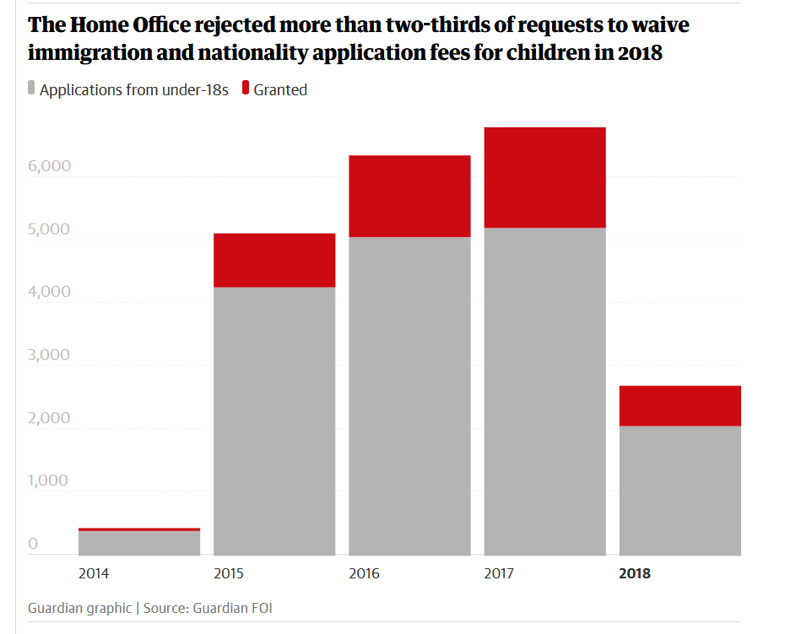
3.​ Application Process and Evidence
https://www.theguardian.com/uk-news/2019/apr/04/over-70-of-uk-immigration-fee-waiver-requests-by-destitute-are-rejected
________
September 2022

Slide 24
Case Overview
3.​ Application Process and Evidence
You will need to use one single email address for the firm
Online application
Evidence Gathering
Legal Submissions
Fee Waiver
________
September 2022

Slide 25
3.​ Application Process and Evidence
Think about the skills you have as a team
  Tech
  Interpersonal (especially with younger people)
  Financial/budgeting/ spreadsheets
  Legal drafting
  Witness statements
  Organisation
  Evidence gathering
  Each person in the team gets to lead on a particular area suited to their skill-set and can be involved in one or more work streams
Dividing
up the
Work
in your
Team
________
September 2022

Slide 26
3.​ Application Process and Evidence
We recommend scheduling a weekly team call
  Same time
  Same day of the week
  Same agenda – set and led by senior lawyer
  Keep it short and effective
  No excuses!
Senior team members need to lead the way – use your existing structures and make them work for you
  Partner/senior lawyer copied in to all emails/correspondence
  Nothing should leave your office that you would not be happy to see leave on a billable matter (including to your supervising solicitor)
Maintaining the 'Whole Team' Approach
________
September 2022

Slide 27
3.​ Application Process and Evidence
1
Client to complete financial diary
2
Scrutinise and analyse income v expenditure and savings regularly
3
Decide whether you apply by post or online
Agree whether your team will receive evidence daily or weekly
Consider whether you need a witness statement
Consider whether third parties need to give a statement or letter
Start to draft application form with client (as early as possible!!)
Team set up WhatsApp group for client to use
Prepare your client for the possibility of a fee paid application
Steps
in the Process 1
________
September 2022

Slide 28
3.​ Application Process and Evidence
Preparing evidence
Does the registration application allow for a fee waiver?
Whose finances need to be assessed
Are they working or claiming benefits?
Do they have permission to work and claim benefits?
Who has bank accounts and have you seen them all?
Taking detailed instructions and drafting witness evidence
Persuading friends/relatives to come on board
Will you apply online or on paper?
Evidencing
the
Application
– Practical
Issues
________
September 2022

Slide 29
3.​ Application Process and Evidence
Points to note
The burden lies with your client
The standard of proof: balance of probabilities
Partial fee waivers for a single applicant are not possible
Multiple applicants require separate fee waivers
Part payment (of a full fee) maybe possible if the finances suggest
The HO may do credit checks – you may want to consider performing one with your client’s permission
There is ‘evidential flexibility’
Best Interests
Evidencing the Application
– Practical Issues
________
September 2022

Slide 30
3.​ Application Process and Evidence
Income
Who is responsible for the child?
Employment (check no of jobs, zero hours etc)
Public Funds
Support from friends
Charities
The Home Office Approach to Essential Living Needs
________
September 2022

Slide 31
3.​ Application Process and Evidence
Expenditure “Accommodation and essential living needs”:
Housing accommodation
Utility bills (Council tax!)
Food and groceries
Household cleaning items
Toiletries
Clothing
Non-prescription medication
Could include: travel and communication to maintain relationships and reasonable level of social, cultural and religious life
The Home Office Approach to Essential Living Needs
Your client may have other items of regular expenditure which are not considered “essential” but which are necessary: children’s extra – curricular interests, support for friends and family members.​
The Home Office will ask whether the spending is ‘reasonable’ or ‘excessive’ (page 14)
________
September 2022

Slide 32
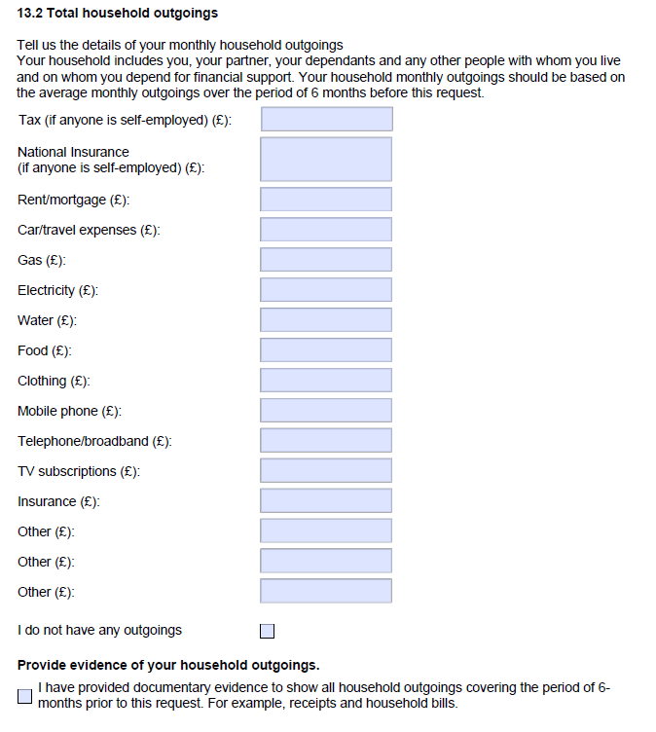
3.​ Application Process and Evidence
Page 40 of the fee waiver paper form seeks a break down of outgoings:
________
September 2022

Slide 33
Example recording in financial diary (template documents will be available)
Date | Income | Expenditure | Amount | Receipts available?
01.01.2022 | Salary |  | £100 | Yes
01.01.2022 |  | Food (Cash at grocers ) | £20.00 | No
05.01.2022 | Universal Credit |  | £326.00 | Yes
06.01.2022 |  | Bus card | £11.00 | Yes
10.01.2022 |  | Shoes for son | £30.00 | Yes
Totals for month
Example assessment of income and expenditure
Month | Income | Expenditure | Surplus | Deficit
Jan | £1500.00 | £1480.00 | £20.00 | -
Feb | £ 1562.00 | £1580.00 | - | £ 18.00
March | £1300.00 | £1225.00 | £75.00 | -
Totals over 3 months |  |  | £95.00 | £18.00 | £77.00
Surplus = income after accommodation + essential living needs
________
September 2022

Slide 34
Timing of the Application
3.​ Application Process and Evidence
Date of application is the date it is received by the Home Secretary
  "Date of application
  The date of application is the date it is received by the appropriate receiving authority, [ie Home Secretary].
  Where an application for a fee waiver is received that contains all the relevant application, the date it is received can be treated as the date of application. This is particularly relevant if the person has turned 18 between making the fee waiver application and sending in their application form.”
  (General information – all British nationals: nationality policy guidance, page 9)
________
September 2022

Slide 35
Timing of the Application
Consider the date by which the fee waiver must be submitted to receive a decision in time to submit the registration application before the client reaches the age of majority.
The fee waiver is not a citizenship application
What happens where you have a border-line fee waiver application, or your fee waiver is refused and the client has ‘aged out’?
If the applicant turns 18 after applying for a fee waiver but before applying for citizenship, for their citizenship application to be treated as though it was submitted on the date of the fee waiver request, they must apply for citizenship, and submit payment within 10 working days of the fee waiver refusal being communicated.
3.​ Application Process and Evidence
________
September 2022

Slide 36
Paper Application Process
3.​ Application Process and Evidence
We would always recommend the online application process over the paper forms and postal applications
If submitting by post, the fee waiver, registration application and supporting evidence for each must be submitted together
Send documents by registered post
Be clear about which documents are copies and which originals
The postal address is in the guidance appropriate to your application
________
September 2022

Slide 37
The Online Application Process
3.​ Application Process and Evidence
If you require a fee waiver you will need to make the online fee waiver application first followed by online registration application
The online applications can be saved and returned to – an early attempt can flag up the issues and evidence likely to arise
PDF drafts can be shared with your client and supervisor
The online process is rigid and sometimes unable to capture the reality of people’s lives
Your registration application and supporting evidence must be close to readiness for submission when the fee waiver is submitted
________
September 2022

Slide 38
3.​ Application Process and Evidence
4
Draft legal submissions in support of fee waiver and registration applications
Finalise evidence of financial situation
5
Receive decision on fee waiver application
Submit registration application
6
Family attend Service Centre to submit documents and enrol biometric information
Home Office decision
Negative fee waiver decision? Consult Supervisor!
Steps
in the
Process 2
________
September 2022

Slide 39
4.
Working With Children and Families

Slide 40
4.​ Working With Children and Families
Don’t underestimate the difference you make by welcoming the family to your office ​
Provide an excellent service/client care to the family ​
Meticulously preparing the fee waiver evidence will mean the application is of a very high standard ​
Showing the family that someone cares about their case and is trying to help them
Supporting the family to gather the evidence they need for the application and appreciating the importance of the application to them.
Your Role and the Difference You Will Make
________
September 2022

Slide 41
5.
Top Tips
Melissa Dames
Solicitor​, Arnold & Porter​
​
Melissa shares experience of fee waiver applications for KiND families.

Slide 42
6.
Questions?

